Slide 1

A gamified introduction to Python Programming Lecture 5 Looping with while statements
Matthieu DE MARI – Singapore University of Technology and Design

Slide 2

Outline (Chapter 5)
What is the while statement?
What are infinite loops, why are they problematic and how to stop them?
What is the break statement and how to use it in while statements?
What are good practices when it comes to using while loops?
(If time allows, let us discuss recursion!)

Slide 3
The while statement
The while statement is another type of conditional structure.
How it works:
If the Boolean condition specified for the while statement is True, then execute the block of code inside the while statement.
If the Boolean condition is False, ignore the block of code in the while statement.
The if statement is the simplest conditional structure.
How it works:
If the Boolean condition specified for the if statement is True, then execute the block of code inside the if statement.
If the Boolean condition is False, ignore the block of code in the if statement.
Once we are done executing the code in if (or ignoring it), move on to the next (non-indented) line.

Slide 4
The while statement
The while statement is another type of conditional structure.
How it works:
If the Boolean condition specified for the while statement is True, then execute the block of code inside the while statement.
If the Boolean condition is False, ignore the block of code in the while statement.
Once we are done executing the code in while, move back to the while statement, and repeat until the condition is no longer True.
The if statement is the simplest conditional structure.
How it works:
If the Boolean condition specified for the if statement is True, then execute the block of code inside the if statement.
If the Boolean condition is False, ignore the block of code in the if statement.
Once we are done executing the code in if (or ignoring it), move on to the next (non-indented) line.

Slide 5
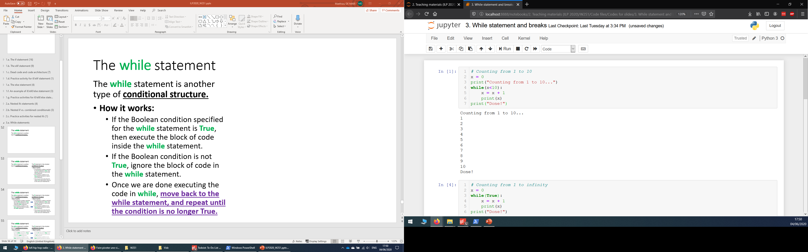
The while statement
The while statement is another type of conditional structure.
How it works:
If the Boolean condition specified for the while statement is True, then execute the block of code inside the while statement.
If the Boolean condition is False, ignore the block of code in the while statement.
Once we are done executing the code in while, move back to the while statement, and repeat until the condition is no longer True.

Slide 6
Architectures: if vs. while
Is condition in the while statement True?
Yes
No
Execute the code inside of the while block
Move on to the next non-indented line of code
Is condition in the if statement True?
Yes
No
Execute the code inside of the if block
Move on to the next non-indented line of code
Ignore the code in the if block

Slide 7
Value of x = 0 Value of x<10 = True While loop triggers
Execute x = x+1
Value of x = 1 Value of x<10 = True While loop triggers
Execute x = x+1
Value of x = 2 Value of x<10 = True While loop triggers
…
Value of x = 10 Value of x<10 = False While loop stops
Value of x is now 1
Print value of x (1)
Value of x is now 2
Print value of x (2)
Do not execute code in while loop anymore
Print “Done!”
SOME MORE ITERATIONS

Slide 8
Infinite loops
The while statement repeats a condition until it is no longer True.
This means that there should be a clear process that makes your condition no longer True, at some point.

Slide 9
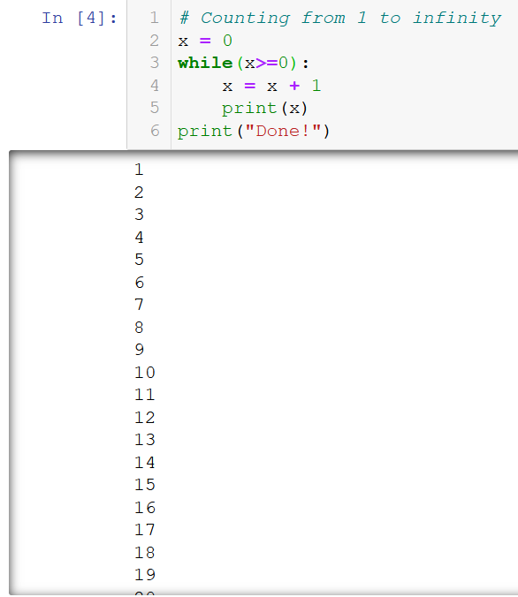
Infinite loops
The while statement repeats a condition until it is no longer True.
This means that there should be a clear process that makes your condition no longer True, at some point.
Otherwise, big problem!
The while block will keep on repeating indefinitely… This is called an infinite loop.

Slide 10
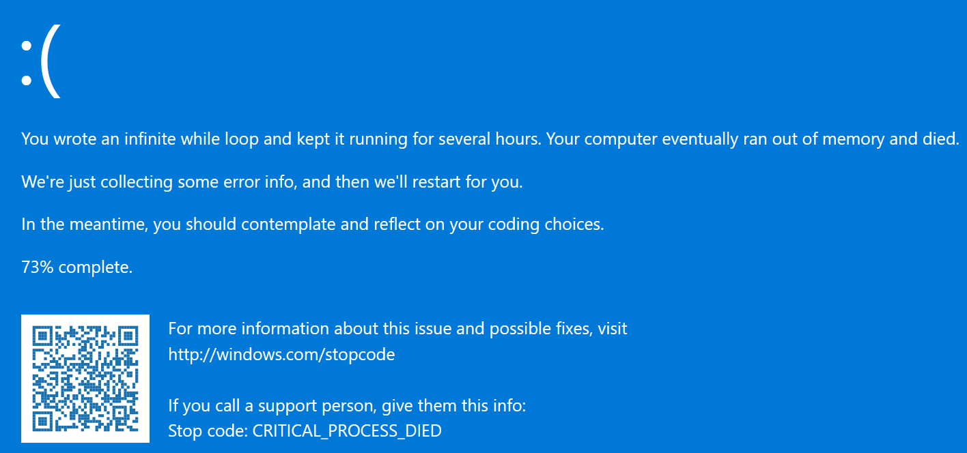
Infinite loops and how to kill them
Infinite loops will keep on executing forever, unless
Your computer runs out of resources/memory and performs an emergency shutdown before exploding (bad thing to do),

Slide 11
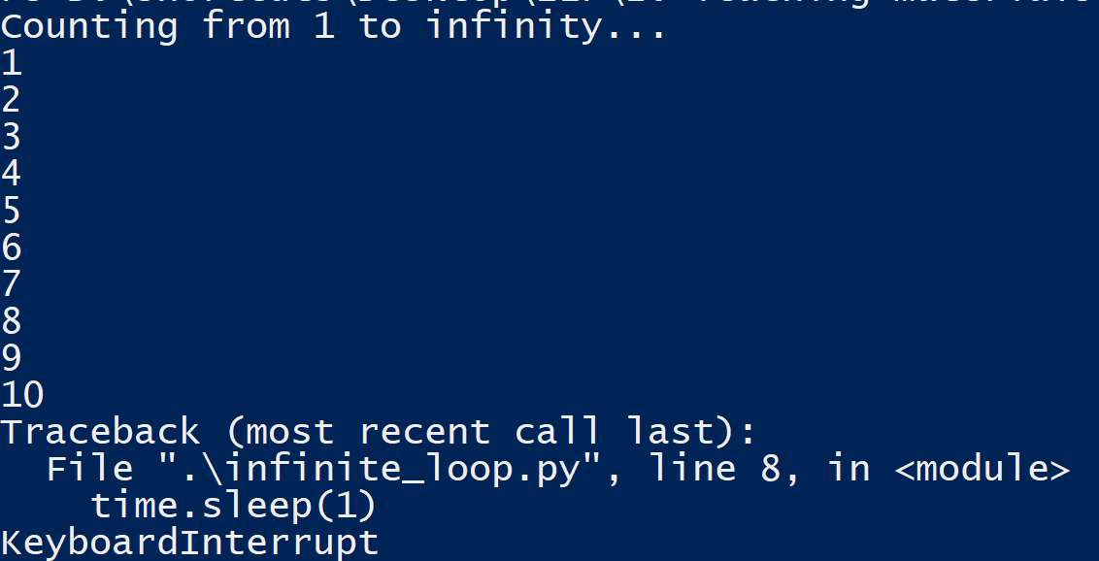
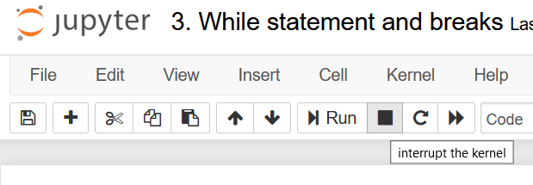
Infinite loops and how to kill them
Infinite loops will keep on executing forever, unless
You decide to crash the program on purpose and kill the loop manually.
This is called a keyboard interrupt. It is done by pressing (repeatedly) CTRL+C (or CMD+C on mac), in console mode and most IDEs.
Or, by using the stop button on Jupyter.

Slide 12

Infinite loops and how to kill them
How it feels when you perform a keyword interrupt on your poor Python
Infinite loops will keep on executing forever, unless
You decide to crash the program on purpose and kill the loop manually.
This is called a keyboard interrupt. It is done by pressing (repeatedly) CTRL+C (or CMD+C on mac), in console mode and most IDEs.
Or, by using the stop button on Jupyter.
KEYBOARD INTERRUPT

Slide 13
Infinite loops and how to kill them
Infinite loops will keep on executing forever, unless
You decide to crash the program on purpose and kill the loop manually.

Slide 14
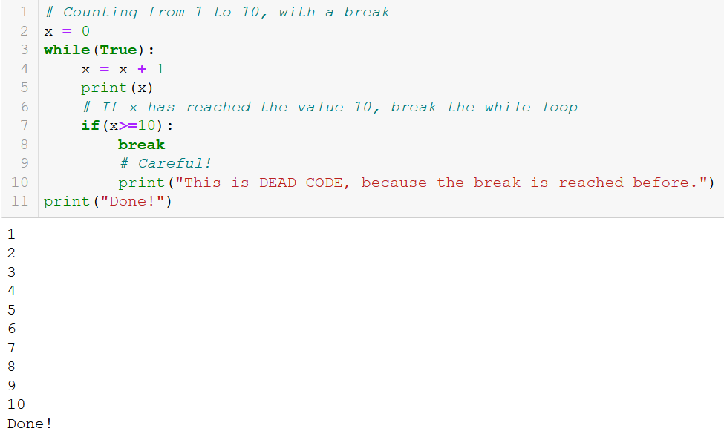
Infinite loops: the break statement
Infinite loops will keep on executing forever, unless
You use a break statement.
When encountered, the break statement will immediately end the current while loop.
The code then resumes its execution with the next line outside of the while block.

Slide 15
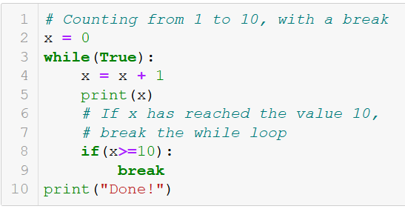
Standard while vs. infinite while + break
Standard while loop with condition in the while statement.
Infinite while loop with condition in an if statement, and break in the if block.
→ Both loops work and do the job, which one is better though?

Slide 16
Matt’s Great Advice
Matt’s Great Advice: Avoid the infinite loops, if possible (part 2).
Relying on an infinite while loop with a break is risky and should be avoided when possible.

Slide 17
Matt’s Great Advice
Matt’s Great Advice: Avoid the infinite loops, if possible (part 2).
Relying on an infinite while loop with a break is risky and should be avoided when possible.
It is often easily avoided, by using the Boolean expression of the if statement used for break, as the condition in the while statement.

Slide 18
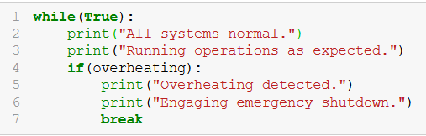
Matt’s Great Advice
Matt’s Great Advice: Avoid the infinite loops, if possible (part 2).
Relying on an infinite while loop with a break is risky and should be avoided when possible.
It is often easily avoided, by using the Boolean expression of the if statement used for break, as the condition in the while statement.
Note: A few cases, however, require the use of a break statement. For instance, emergency shutdowns.

Slide 19
Some more advice before we practice
Understand the loop’s purpose: Before writing a loop, understand what you're trying to achieve. Is it iterating over a sequence until a condition is met, or repeating an action a certain number of times?
Write a simple pseudocode on paper: Outline the logic of your loop in plain language or pseudocode. You NEED to clarify your thoughts before jumping into actual coding. Remember, this is step 1 for the life of a programmer! How are you supposed to translate into code a logic that you have not yet clarified begin with?
Set a clear stopping mechanism: Make sure the loop has a well-defined condition that will eventually turn false, preventing infinite loops. Ask yourself, “Under what condition will this loop stop?”.

Slide 20
Some more advice before we practice
Start simple and refactor: Do not try to figure the entire code at once and hope you will land the correct solution in one shot. It is often better to start simple, and then refactor/improve the loop, progressively adding more operations, in a controlled manner.
Review and simplify: After getting your loop to work, revisit the code to see if it can be improved or be made more efficient. As you become more comfortable with loops, you will start noticing common loop patterns that can be reused in other problems.

Slide 21
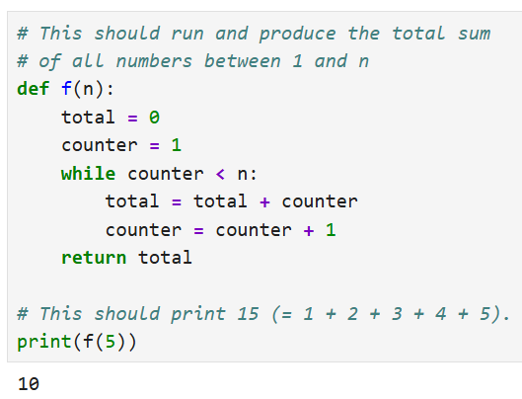
Some more advice before we practice
Use and abuse the print!!!: Display the values of key variables at each iteration, to understand how your loop progresses and identify issues. You can always comment them/remove them later. Control your loops and do not trust your code!
→ Important Note: Call me for debugging + no prints = 2 SGD.
This does not produce the expected result, even though the code looked right?

Slide 22
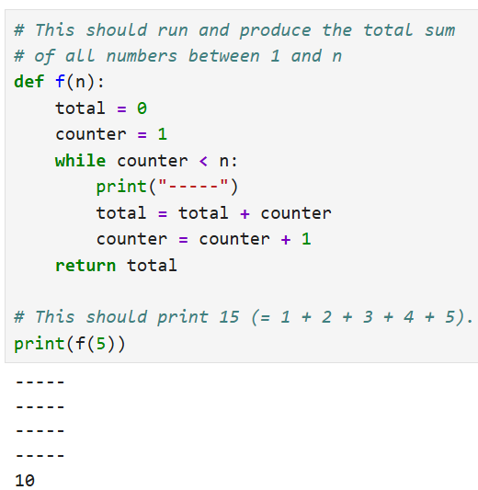
Some more advice before we practice
Use and abuse the print!!!: Display the values of key variables at each iteration, to understand how your loop progresses and identify issues. You can always comment them/remove them later. Control your loops and do not trust your code!
→ Important Note: Call me for debugging + no prints = 2 SGD.
Adding a print of dashes at the beginning will show dashes at the beginning of each iteration.
(Already shows that the loop did 4 iterations, instead of 5)

Slide 23
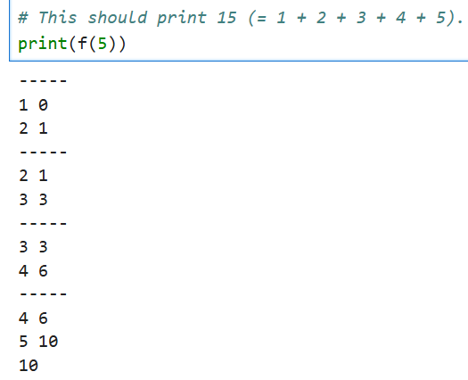
Some more advice before we practice
Use and abuse the print!!!: Display the values of key variables at each iteration, to understand how your loop progresses and identify issues. You can always comment them/remove them later. Control your loops and do not trust your code!
→ Important Note: Call me for debugging + no prints = 2 SGD.
We can confirm that the counter variable went through the values 1, 2, 3, 4 at the beginning of the loops. The counter correctly increments by one at the end of the loop (Correct).
And that the total variable went through the values 0, 1, 3, 6, 10.
This is also correct as it adds the value of counter at the beginning of the loop to the current value in the total variable (Correct).
The issue is that we only perform 4 iterations and never add the counter value 5 to total.

Slide 24
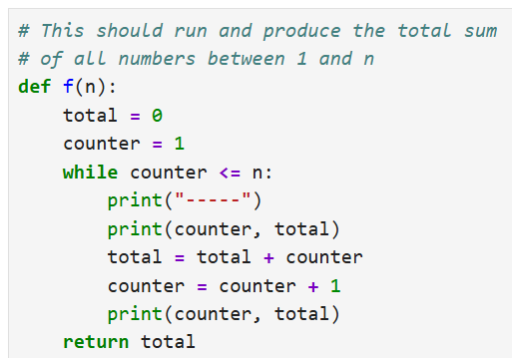
Some more advice before we practice
Use and abuse the print!!!: Display the values of key variables at each iteration, to understand how your loop progresses and identify issues. You can always comment them/remove them later. Control your loops and do not trust your code!
→ Important Note: Call me for debugging + no prints = 2 SGD.
The fix is then to adjust the Boolean condition, replacing < with <=, to allow for one more itertation, the last one we were missing.

Slide 25
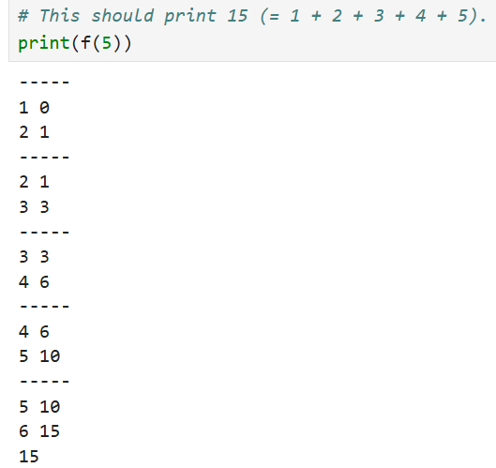
Some more advice before we practice
Use and abuse the print!!!: Display the values of key variables at each iteration, to understand how your loop progresses and identify issues. You can always comment them/remove them later. Control your loops and do not trust your code!
→ Important Note: Call me for debugging + no prints = 2 SGD.
The prints will show that the adjustment worked! (Code is fixed!)

Slide 26
Matt’s Great Advice
Matt’s Great Advice: Avoid the infinite loops and dead code, by working on pen and paper first.
Infinite loops and dead code, unless created on purpose (!), usually follow from a poor design in your code.
Drawing a structural diagram, before coding, greatly helps figuring out the right structure for your code.
Use prints in your loops to see them in action and confirm their behavior!
Use pen and paper as well if it helps!

Slide 27
Matt’s Great Advice
Is the value of x greater than 10?
Yes
No
print(x) and increment x by one
print(“Done.”)
Initialize x as 0
Matt’s Great Advice: Avoid the infinite loops and dead code, by working on pen and paper first.
Infinite loops and dead code, unless created on purpose (!), usually follow from a poor design in your code.
Drawing a structural diagram, before coding, greatly helps figuring out the right structure for your code.
Use prints in your loops to see them in action and confirm their behavior!
Use pen and paper as well if it helps!
Example: diagram for our while loop, counting from 1 to 10.

Slide 28
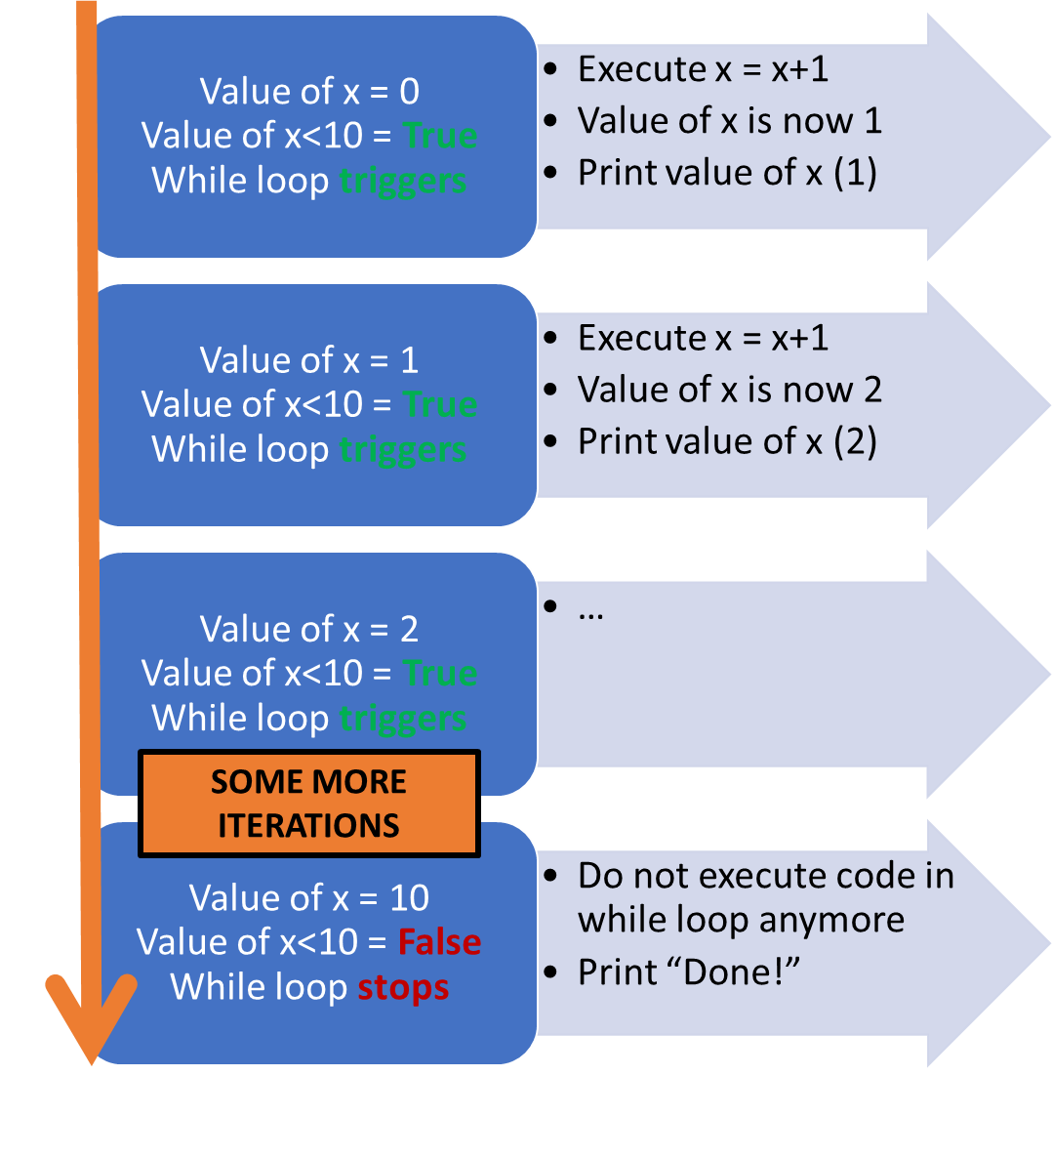
Matt’s Great Advice
Matt’s Great Advice: Avoid the infinite loops and dead code, by working on pen and paper first.
Infinite loops and dead code, unless created on purpose (!), usually follow from a poor design in your code.
Drawing a structural diagram, before coding, greatly helps figuring out the right structure for your code.
Use prints in your loops to see them in action and confirm their behavior!
Use pen and paper as well if it helps!
Example: diagram for our while loop, counting from 1 to 10.

Slide 29
Conclusion (Chapter 5)
What is the while statement?
What are infinite loops, why are they problematic and how to stop them?
What is the break statement and how to use it in while statements?
What are good practices when it comes to using while loops?
(If time allows, let us discuss recursion!)

Slide 30
Quiz time!
Let’s go!

Slide 31



Please download and install the Slido app on all computers you use
What will be printed?
ⓘ Start presenting to display the poll results on this slide.

Slide 32
Please download and install the Slido app on all computers you use
What will happen here?
ⓘ Start presenting to display the poll results on this slide.

Slide 33
Please download and install the Slido app on all computers you use
Which statement should we use in the while loop, in order NOT to get stuck in a while loop?
ⓘ Start presenting to display the poll results on this slide.

Slide 34
Please download and install the Slido app on all computers you use
Which of the following statements is NOT true about break statements in while loops?
ⓘ Start presenting to display the poll results on this slide.

Slide 35
Practice activities for while/break
Let us practice the while/break concepts a bit, with three activities.
Activity 1: How much experience needed for level n?
Activity 2: How many hits can you take?
Activity 3: Guess the card game, v2.
(And as usual, some extra practice/extra challenges!)

